Slide 1
ITFN: 4202 Database applications
Group 1:
Larry Uchime
Jessica Wilson
Henry Jester
Sarina Bell
Notes:
This template is in wide-screen format and demonstrates how transitions, animations, and multimedia choreography can be used to enrich a presentation.

Slide 2

Database Project Proposal: PACE Community Engagement Projects Database
The Clayton State University Partnering Academics and Community Engagement (PACE) program would like to develop a system to provide faculty and administration personnel better visibility to community engagement projects sponsored or supported by:
Clayton State University
Its programs
Colleges
Departments
Individual courses

Slide 3
Project Milestone Summary
Inspire Others
Work Smart
Exceptional Results
Milestone 4: Project consolidation
Milestone 5: Form and Report Development
Milestone 6: Web Front End

Slide 4
Milestone 4: Project consolidation
Develop and enforce constraints
Client's business objectives
Consolidate existing community engagement project records
Update or modify existing community engagement projects
Allow search for list of engagement projects by selected search criteria
Assumptions
An organization can have many engagements
Student can be involved in many engagements
An engagement can be held at many locations
RSD

Slide 5
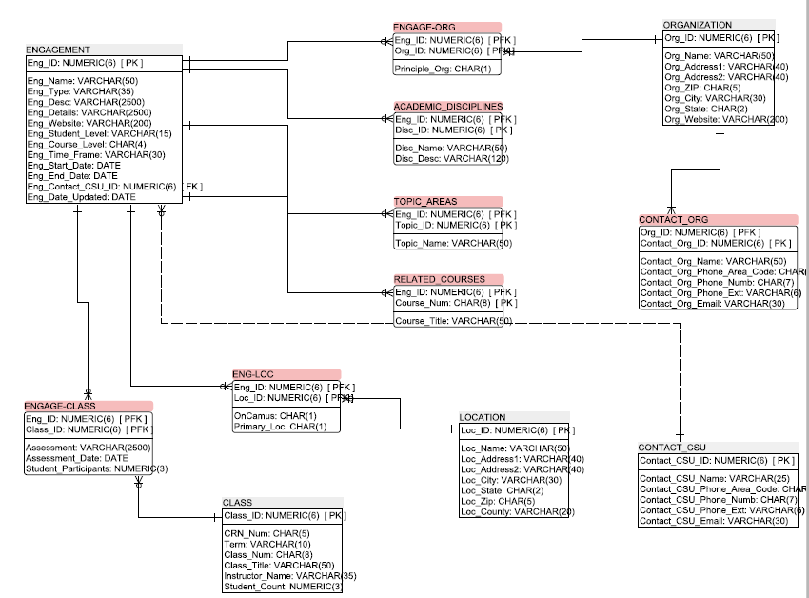
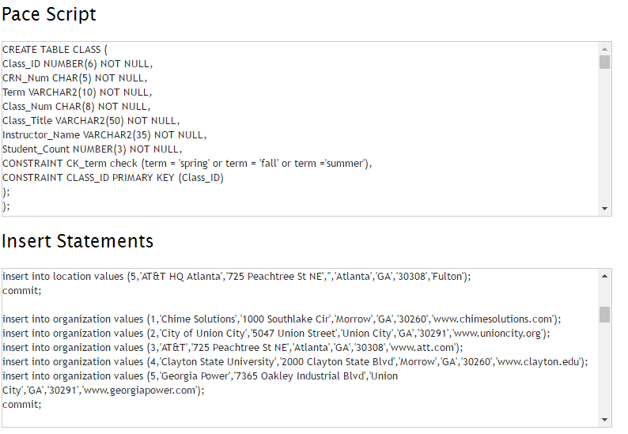

Slide 6
Milestone 5: Form and Report Development
Users will be able to the insert data by using form
Users should be able to view table
Users should insert, select and delete privileges
Users have the role of an admin users and can grant privilege to other users
Users will be able to the insert data by using form
Users should be able to view table
Users should insert, select and delete privileges
Users have the role of an admin users and can grant privilege to other users
Design forms and reports
Develop and implement needed:
Views
Roles and privileges
Users will be able to the insert data by using form
Users will have insert, select and delete privileges
PL/SQL procedures
Outline user guides and procedures.

Slide 7
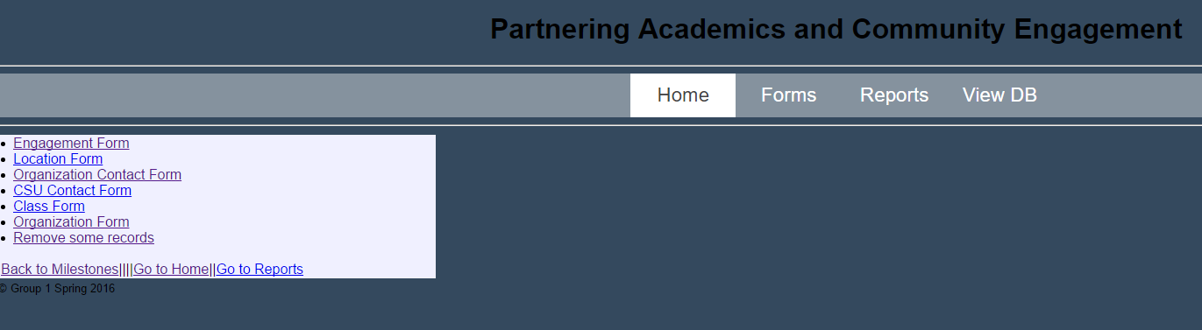
PACE Website

Slide 8
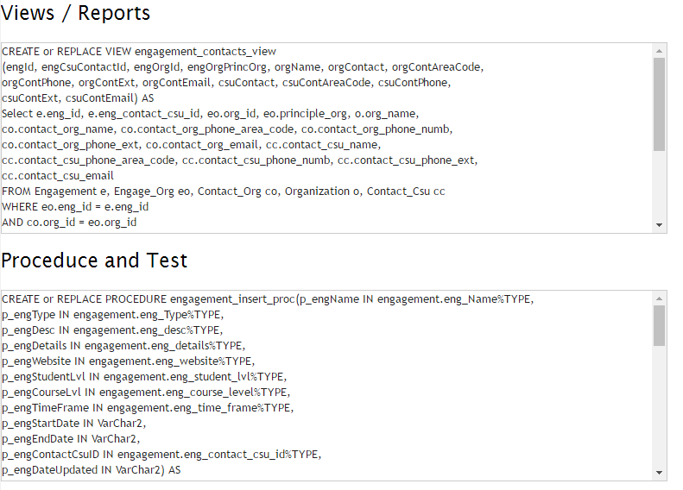

Slide 9
Milestone 6: Web Front End
Complete all forms and reports
The PACE forms are to input information into the PACE database. The forms goes as follow:
Engagement Form
Location Form
CSU Contact Form
Class Form
Organization Form
Consolidate all web page development using a menu
Menu executes all forms and reports developed in Milestone 5.
Web pages connect to the database using appropriate connectivity options.

Slide 10
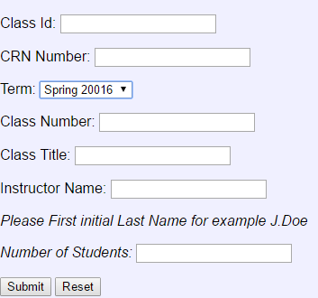
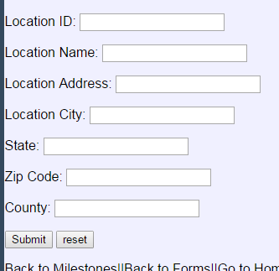
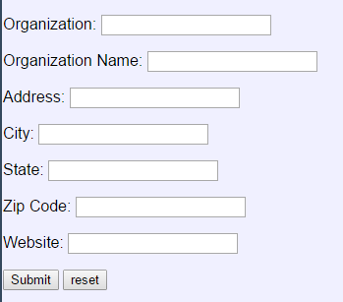
COMPLETION OF FORMS AND REPORTS
Completed forms and reports designed in Milestone 5

Slide 11
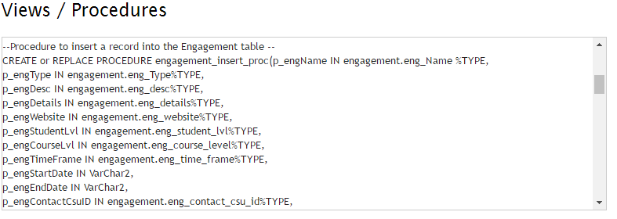
Views and Procedure

Slide 12

Project Presentation Conclusion
Questions/Concerns?
“Thank you for your attention and allowing us to present our project!”
~Group 1

Slide 13
Reflection
Overall, we feel that the project was successful because we fulfilled all required tasks. We had complications while trying to complete some of the tasks. Some of the challenges we faced were narrowing down the list of forms and reports that we felt were pertinent and could be the most beneficial for the users, being able to connect to the DB to pull information for our reports and to insert information into the DB, and last but certainly not least, creating a procedure to update the Engagement table. Despite all of the challenges we faced along the way, we were able to overcome them and complete the project by the specified deadline.

Slide 14
Project Presentation Conclusion
Questions/Concerns?
Enter THE PACES
“Thank you for your attention and allowing us to present our project!”
~Group 1

